Slide 1


CSUP Needs Assessment
Substance Use Prevention Introduction
What do we mean when we talk about Substance Use/Misuse Prevention?
Substance use and dependence considerably affects the quality of life of individuals, reduces life expectancy, results in high health care costs. ¹
Substance use takes a toll on individuals, families, and the community. ¹
Substance use prevention involves more than reducing or stopping the use of substances such as alcohol, drugs, and tobacco. ¹
  It involves:
    Decreasing and prevention of the consequences of substance use¹
    Building mental and emotional health of individuals to reduce the burden¹
    Addressing costs associated with substance use and dependency¹
    Creating communities that support and encourage each other¹
Statistics
  “An estimated 23.5 million Americans ages 12 and older needed treatment for an illicit drug or alcohol use problem. That is 1 out of every 10 people.” ¹
  “The annual total estimated societal cost of substance abuse in the United States is about $511 million.”¹
  “Around 2.5 million adults with a serious mental illness are also dependent on or abuse drugs or alcohol^{.”1}
  “Half of all lifetime cases of mental and substance use disorders begin by age 14, and three-fourth being at age 24. ” ¹
  STOPPING SUBSTANCE USE BEFORE IT STARTS (E.G., PRIMARY PREVENTION) IS ESSENTIAL FOR ADDRESSING SUBSTANCE USE IN THE COMMUNITY!
Terminology
  “Substance Use is the consumption of low and/or infrequent doses of alcohol and other drugs that damaging consequences may be rare or minor.” ¹
  “Substance Misuse is the use of a substance for the purpose not consistent with legal or medical guidelines. This often describes the use of prescription drugs in a way that may vary for medical direction or someone else’s prescribed drug for medical or recreational use.” ¹
  “Substance Abuse is when alcohol or drug use adversely affects the health of the user or when the use of a substance imposes social and personal costs.” ¹
  “Substance Dependence is a compulsive craving from a substance. It is a chronic and progressive disease, and withdrawal is usually characterized by physiological symptoms.” ¹
  Source: Great Lakes Prevention Technology Center (PTTC) Network: Introduction to Substance Abuse Prevention: Understand the Basics, Module 2
We will refer to all definitions under the umbrella of “substance use” or “substance misuse” to prevent further stigmatization and dehumanization of people who use drugs (PWUD). We will also refer to “substance dependence” as substance use disorder.
Created by Miranda Griechen, BA, MPH, Public Health Educator, Pennington & Red Lake County Public Health & Home Care
1

Slide 2


CSUP Needs Assessment
Risk and Protective Factors
Youth
Risk Factors
Perceptions around drug use²
  Parents
  Friends
  Individual
Trauma or home instability²
Low education²
Low income²
Lack of mentor or strong role model²
Home instability²
Poor mental health²
Increased social media use²
History of substance use²
Genetic Factors²
Easy access to substances
Protective Factors
School connectiveness²
Strong role model or mentor²
Parental involvement³
High social competence²
Good emotional regulation²
Support and resilience²
Positive community norms
Adults
Risk Factors
Adverse childhood experiences³:
  Growing up around substance use
  Child abuse or maltreatment
Substance use as a youth³
Poor mental health³
Community poverty and violence³
Social norms and laws around substance use³
Genetic factors³
Protective Factors
Strong role models or parental figures as a child³
Laws on regulation and availability³
Community based programs/organizations³
  Faith-based organizations³
For more information, please visit:
Preventing Drug Use Among Children and Adolescents -- A Research-Based Guide for Parents, Educators, and Community Leaders
SAMHSA Risk and Protective Factors
Created by Miranda Griechen, BA, MPH, Public Health Educator, Pennington & Red Lake County Public Health & Home Care
2

Slide 3
CSUP Needs Assessment
National Data on Substances
  Current alcohol use among youth has decreased from ~50% in 1991 to 22.7% in 2021. ⁴
  Current cigarette use among youth has decreased from 27.5% to 3.8% in 2021. ⁴
  Current e-cigarette use among youth has decreased from 24.1% in 2015 to 18.0% in 2021.⁴
  Current marijuana use among youth has stayed stable since 1991 to 2021 at ~15%. ⁴
  Lifetime illicit drug use among youth has decreased from 26.5% in 1991 to 13.3% in 202. ⁴
  7.7% of US adults are currently using e-cigarettes (CDC BRFSS 2023). ⁵
  Around 3% of adults currently use smokeless tobacco products (e.g., chewing tobacco, snuff) in 2023. ⁵
  52.2% of US adults are have had at least one alcoholic beverage in the past 30 days (CDC BRFSS 2023).⁵
  12.1% of US adults are currently smoking cigarettes in 2023.⁵
  According to the Federal Bureau of Investigation, 1,558,862 crimes committed during 2019 were drug abuse violations.⁶
    Drunkenness was 316,032. ⁶
  From 2023-2024, there was a decrease of 26.9% of overdose deaths in the US (110,037 in 2023 to 80,391 in 2024). ⁷
  Adverse childhood experiences (ACEs) are abuse, neglect, and house instability during childhood that may affect chronic conditions and lifestyle behaviors in adulthood. ⁶ Those with 4 or more ACEs were more likely to be currently using marijuana (OR= 4.7), currently smoking) (OR=3.1), and have poor mental (OR=5.9), and physical health (OR=3.7). ⁸
  Cannabis may alter the epigenetic process with functional genes that may express genes leading to the development of autism spectrum disorder, attention deficit hyperactivity disorder, schizophrenia, addiction, and other psychiatric diseases. ⁸
  Increases risk for pneumonia, gastrointestinal adverse events, somnolence, psychotic (5.21 times) and total psychotic symptoms (7.49 times), and cognition (especially increased risk for car crash (1.27 times) from cannabis use. ⁹
    High to moderate certainty for increased adverse events related to the CNS (2.84 odds), psychological effects (3.07 odds), and vision (3.00 odds). ⁹
  Increases the risk (1.43 times) of low birth weight, small for gestational age (1.61 times) for infant for pregnant women who use cannabis.¹⁰
  Dose-response relationship with marijuana use and the risk of cannabis use disorder. Yearly use: 2.0 times increased risk. Monthly use: 4.12 times increased risk. Weekly use: 16.99 times increased risk. ^{11,12}
  Alcohol use has been positively correlated with over 61 diseases, with over 2 times increased risk of larynx cancer and over 9 times increased risk alcoholic liver disease for ever regular versus occasional drinking. Many of the RR were over 1 for both occasional and current drinkers. From other studies, adverse effects are often worse in women as the liver does not metabolize alcohol as efficiently as men.¹³
  Smoking and tobacco products have been linked to cardiovascular outcomes such as stroke, myocardial infraction, coronary heart disease, and heart failure. ¹⁴
  Smoking and tobacco products have also been linked to many types of cancer such as lung cancer, bladder cancer, breast cancer, and mouth cancer. ^{15, 16, 17, 18}
  E-cigarettes have been implicated with respiratory chronic health conditions such as chronic obstructive pulmonary disease (COPD). ¹⁹
  Caution: Some of this data was collected prior to the legalization of marijuana in some states, others it is still illegal to use.
Created by Miranda Griechen, BA, MPH, Public Health Educator, Pennington & Red Lake County Public Health & Home Care
3
Notes:
Chronic Pain Patients in the Minnesota Medical Cannabis Program
Balancing risks and benefits of cannabis use: umbrella review of meta-analyses of randomised controlled trials and observational studies – PubMed
Identifying risk-thresholds for the association between frequency of cannabis use and development of cannabis use disorder: A systematic review and meta-analysis – PubMed
Cannabis Exposure During Critical Windows of Development: Epigenetic and Molecular Pathways Implicated in Neuropsychiatric Disease – PMC
Youth Online: High School YRBS - United States 2015 — 2021 Results | DASH | CDC
Identifying risk-thresholds for the association between frequency of cannabis use and development of cannabis use disorder: A systematic review and meta-analysis – PubMed
BRFSS Prevalence & Trends Data: Home | DPH | CDC
Risk factors for clozapine-induced myocarditis and cardiomyopathy: A systematic review and meta-analysis – PubMed
Alcohol consumption and risks of more than 200 diseases in Chinese men – PMC
Predictors of incident stroke among individuals without coronary artery calcification: A pooled cohort analysis from the Multi-Ethnic Study of Atherosclerosis, Jackson Heart Study, and Framingham Heart Study – PubMed
Dose-response Relationships Between Cigarette Smoking and Breast Cancer Risk: A Systematic Review and Meta-analysis – PubMed
Cigarette Smoking Reduction and Health Risks: A Systematic Review and Meta-analysis – PubMed
Projection of the prevalence of tracheal, bronchus, and lung cancer incidence using cigarette smoking prevalence in Iran from 1990 to 2018: a comparison of latent period-based models with standard forecasting models – PubMed
Cigarette smoking and risk of bladder cancer: a dose-response meta-analysis – PubMed
Respiratory chronic health conditions and racial disparities associated with e-cigarette use: a cross-sectional analysis using behavioral risk factor surveillance data - PubMed

Slide 4
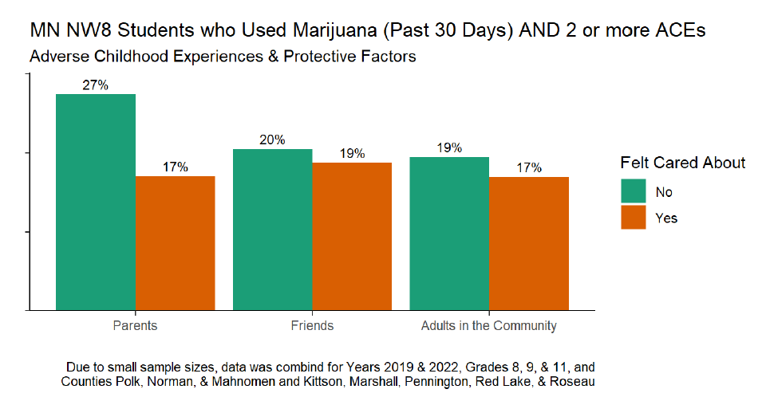
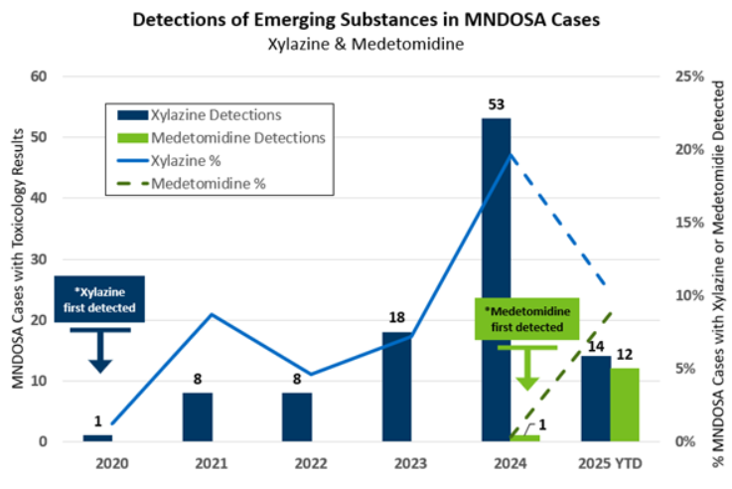
CSUP Needs Assessment
State Data on Substances
Minnesota
Since 2014, the potency of marijuana products has increased by 39% since 2020. ²⁰
  Youth
  Cannabis use in the past year in youth 12-17 (~11% (8.2%, 14.6%) ²⁰
  Cannabis poisonings (2018-2022) 0-5 from 7% to 22%, 6 to 19 42%-28%, 20+ 50%-49%.²⁰
  Majority of youth aren’t using cannabis (over 75%).²⁰
    89.3% reported never using cannabis ²⁰
  11.7% of 9th and 11th graders are using alcohol²¹
  10.3% are using e-cigarettes²¹
  The possession of more than 1.4 grams and unlawfully selling marijuana has decreased. ²²
    Only 169 drug arrests were under 18 in Minnesota during 2024. ²²
    There was an increase 2% in youth being charged with possessing one or more mixtures contained a controlled substance (schedule I-IV). ²²
  Use and Misuse for Prescription Drug and Opioids has increased across all age groups, but specifically 8th graders from 0.8% in 2013 to 5.2% in 2022. ²³
  Adults
  Current Cigarette Smoking among adults was 12.2% (11.4%-13.0%). ²⁴
  Cannabis use in the past year 18 +23.1% (20%, 26.6%) ²⁴
  Current e-cigarette use among adults was 7.0% (6.4%-7.7%) ²⁴
  Heavy alcohol use was 5.9% (5.4%-6.5%) ²⁴
  Most adults bought menthol tobacco products at a Gas Station (43.0% (36.8%-49.5%)) or a store that sells only tobacco products (37.7% (31.7%-44.1%) ²⁴
  Most adults are eating or drinking cannabis as the primary mode of use (2.4%-14.9%) in 2017-2022²⁴
    Most people use medical cannabis for pain, especially from severe and terminal illness (Chronic Pain Patients in Minnesota Medical Cannabis Program).²⁵
    However, in 2023, 53.2% (49.9%-56.6%) smoked it.²⁵
  Most individuals are using cannabis for non-medical purposes to get pleasure or satisfaction (42.2% in 2022).²⁶
  Males were more likely to use cannabis than females (16.5% versus 13.0%) and smoke cigarettes (17.9% versus 8.8%).²⁶
  25-44 age group most common for past 30-day marijuana usage (23%) ²⁶
  45-64 age group most common for cigarette smoking (20.9% (10.8%-36.6%) ²⁶
  Non-Hispanic American Indian/Alaskan Natives are using marijuana more (past 30-day usage)(25.6%).²⁶
  Those with less than high school education and who make <$25,000 per year are using cannabis more (past 30-day usage) (16.2%).²⁶
  More common to see marijuana use among those disabled (21.1%) and LGBT+ (32.7%).²⁶
  Cannabis users are more likely to have poor mental health status (32.2%).²⁶
    Those with good mental health using it nonmedical (55.4%) and those with bad mental health using medical (40.6%).²⁶
    Most with poor mental health were more likely to smoke it (62.7%).²⁶
    Marijana use in the past 30 days for MN adults was associated with 2-2.5 times higher risk of poor mental health outcomes.²⁶
  In 2024, there were 7,459 drug arrests in Minnesota. Most were possessing/concealing crimes, male, white, and due to amphetamines/methamphetamines and marijuana.²²
  Overdose deaths continue to increase from 2019-2023 (421-1011) for opioids. Nonfatal overdoses have continued to increases for all opioids including heroin (2,821 to 4,105) from 2019-2023. Fentanyl and other drug contaminants continue to be a public health priority. ²⁷
  *Caution: Some of this data was collected prior to the legalization of marijuana in MN*
Created by Miranda Griechen, BA, MPH, Public Health Educator, Pennington & Red Lake County Public Health & Home Care
Graph created by Minnesota Drug Overdose and Susbtance Use Surveillance Activity Data (MNDOSA), Division of Injury Prevention and Mental Health, Minnesota Department of Health, 2020-2025.
Graph created by Patrick Olson, Healthy QUIN Counties and Northwest 8 Data Analyst
4
Notes:
Chronic Pain Patients in the Minnesota Medical Cannabis Program
Cannabis use 2024 baseline MN
(Gupta, 2025)

Slide 5
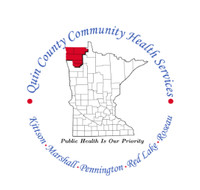
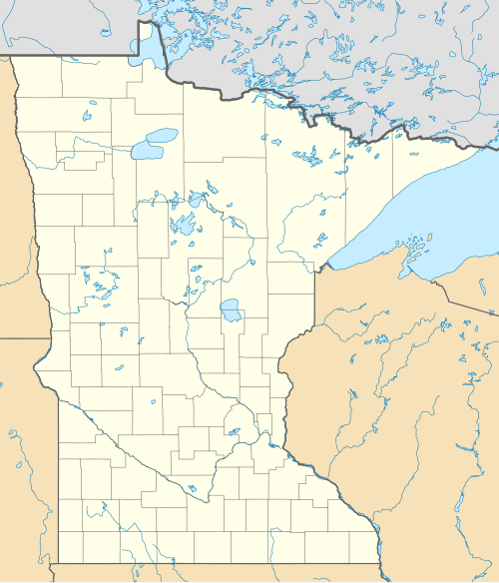
CSUP Needs Assessment
Demographics of QUIN Counties and CHB
Pennington²⁸
Below 18 Years of Age: 22.2%
65 and older: 20.0%
Female: 49.7%
AIAN: 2.2%
Asian: 1.3%
Hispanic: 4.9%
Native Hawaiian or Other Pacific Islander: 0.0%
Non-Hispanic Black: 1.0%
Non-Hispanic White: 88.9%
Disability: Functional Limitations: 26.0%
Not Proficient in English: 1%
Children in Single Parent Households: 13%
Rural: 36.4%
Population 13,741
Red Lake²⁸
Below 18 Years of Age: 24.0%
65 and older: 23.4%
Female: 48.5%
AIAN: 2.3%
Asian: 0.5%
Hispanic: 3.7%
Native Hawaiian or Other Pacific Islander: 0.1%
Non-Hispanic Black: 0.8%
Non-Hispanic White: 90.7%
Disability: Functional Limitations: 25.0%
Not Proficient in English: 0%
Children in Single Parent Households: 20%
Rural: 100%
Population 3,911
Roseau²⁸
Below 18 Years of Age: 23.8%
65 and older: 20.0%
Female: 48.0%
AIAN: 2.1%
Asian: 2.6%
Hispanic: 2.1%
Native Hawaiian or Other Pacific Islander: 0.0%
Non-Hispanic Black: 0.9%
Non-Hispanic White: 90.4%
Disability: Functional Limitations: 25.0%
Not Proficient in English: 1%
Children in Single Parent Households: 21%
Rural: 100%
Population 15,252
Marshall²⁸
Below 18 Years of Age: 23.0%
65 and older: 23.7%
Female: 48.9%
AIAN: 1.0%
Asian: 0.4%
Hispanic: 4.8%
Native Hawaiian or Other Pacific Islander: 0.1%
Non-Hispanic Black: 0.7%
Non-Hispanic White: 92.2%
Disability: Functional Limitations: 28.0%
Not Proficient in English: 1%
Children in Single Parent Households: 23%
Rural: 100%
Population 8,810
Kittson²⁸
Below 18 Years of Age: 21.6%
65 and older: 26.5%
Female: 49.5%
AIAN: 0.8%
Asian: 0.7%
Hispanic: 2.9%
Native Hawaiian or Other Pacific Islander: 0.0%
Non-Hispanic Black: 1.0%
Non-Hispanic White: 93.4%
Disability: Functional Limitations: 28.0%
Not Proficient in English: 0%
Children in Single Parent Households: 11%
Rural: 100%
Population 4,060
Source: County Health Rankings 2025
5

Slide 6


CSUP Needs Assessment
Pennington & Red Lake County
Youth Baseline Assessment: Substance Use
Nonfatal Drug Overdoses 2016-2022 ²⁹
For nonfatal drug overdoses, children 0-4 (21%) and 15-19 (8%) had the highest rates in Pennington County for all drugs. ²⁹
Red Lake county had 6% of children 5-9 suffering from nonfatal drug overdose for all drugs.²⁹
All opioids made up 3% of nonfatal drug overdoses for children 15-19 in Pennington County.²⁹
Stimulants made up 10% of nonfatal overdoses for children 0-4 and 15-19. It made up 5% of nonfatal overdoses for children 10-14.²⁹
Amphetamine made up 11% of nonfatal overdoses in children 0-4 and 6% for children 10-14 and 15-19.²⁹
Benzodiazepine made up of 6% of overdoses for children 0-4 and 15-19.²²
Pennington had 20 youth with drug arrest charges while Red Lake had 0 youth from 2021-2024. ²²
**Data presented is from the Minnesota Student Survey from 2022²⁹ to help guide interventions. These are unweighted estimates, interpret with caution, as they may not be representative of Pennington or Red Lake County due to small sample sizes. Confidence intervals and p-values were not available.
Significant Findings from the Minnesota Student Survey 2022²¹
Many students use e-cigarettes that are often fruit or candy flavored.²¹
Most students get alcohol or e-cigarettes from friends and family.²¹
A large percentage of students believe there is no risk associated with using marijuana.²¹
  30.8% of 9th graders in Pennington
  45.2% of 9th graders in Red Lake
A large percentage of students believe there is no risk associated with 5 or more alcohol drink once or twice per week. ²¹
  21.2% of 9th graders in Pennington
  38.7% of 9th graders in Red Lake
58.1% (Pennington) and 57.1% (Red Lake) of 11th graders have not used alcohol, marijuana, and/or other drugs in the past year.²¹
25.2% (Pennington) and 15.4% (Red Lake) of 9th graders reported feeling bothered, feeling down, depressed or hopeless several days.²¹
**Data presented is from the Minnesota Department of Health’s Nonfatal Drug Overdose Dashboard²⁹, rates and estimates are standardized to the Minnesota population in 2020 using the US Census Bureau. Some data is suppressed due to unstable rates or privacy. Interpret with caution as all drug overdoses are suspected drug overdoses. The last two data points are from the Minnesota Drug Crimes and Overdose Dashboard. Confidence intervals and p-values not available.
For more information, please visit:
Minnesota Student Survey
Nonfatal Drug Overdose Dashboard - MN Dept. of Health
Protecting Youth From the Harms of Vaping | Smoking and Tobacco Use | CDC
Cannabis and Teens | Cannabis and Public Health | CDC
Substance Use Among Youth | Reducing Health Risks Among Youth | CDC
About Underage Drinking | Alcohol Use | CDC
Created by Miranda Griechen, BA, MPH, Public Health Educator, Pennington & Red Lake County Public Health & Home Care
6
Notes:
Trends from the MSS were not added due too small of numbers and lack of variation.

Slide 7

CSUP Needs Assessment
Pennington & Red Lake County
Adult Baseline Assessment: Substance Use
Other Significant Findings
Pennington had 25 nonfatal drug overdoses, and 15 fatal drug overdoses that were reported from 2017-2023. Red Lake did not have any data.^{23, 29}
26.2% (22.7%, 30.0%) of adults in Pennington and 25.8% (21.9%, 29.8%) of adults in Red Lake had depression in 2022.³⁰
Pennington and Red Lake County do not have accurate data, but it’s estimated by the MN EHR Consortium in 2024 that at least 1% of individuals in these counties is suffering from dependence from cannabis, cocaine, and opioids.³¹
  3% alcohol dependence for Pennington
  2% for alcohol dependence for Red Lake27
There is no data for cannabis-poisoning, however cases have increased across the state, including Greater MN. ³¹
Pennington had 224 arrests with amphetamines/methamphetamines and marijuana being most of these arrests from 2021-2024.²²
Red Lake had 21 arrests, with marijuana and amphetamines/methamphetamines being most of these arrests from 2021-2024. ²²
State Data (2022)
Cigarettes 14%
Binge drinking 22%
**Data presented is from the Centers for Disease Control and Prevention’s PLACES data for 2022. ³⁰ The prevalence of cigarette use, and binge drinking was age-adjusted for more accurate interpretations. Confidence intervals may be wide due to sample size limitations.
**Data presented is from the Minnesota Department of Health’s Nonfatal Drug Overdose Dashboard, rates and estimates are standardized to the Minnesota population in 2023 using the US Census Bureau. Some data is suppressed due to unstable rates or privacy. Interpret with caution as all drug overdoses are suspected drug overdoses. Confidence intervals and p-values not available. The second bullet point is also from the Centers for Disease Control and Prevention PLACES data for 2022. The prevalence of depression was age-adjusted for more accurate interpretations. Confidence intervals may be wide due to sample size limitations. The third bullet point comes from the MN EHR Consortium for 2024, and the last bullet point comes from the Minnesota Hospital Discharge Data. Most of the data was collected prior to the legalization of marijuana.
**Data presented is from the Minnesota Behavioral Risk Factor Surveillance System from 2018-2023 ³². These are weighted estimates. Due to the recent legalization of marijuana, there is not a lot of data on marijuana usage for just Pennington and Red Lake. Therefore, estimates were given for the QUIN County Community Health Board which comprises both Pennington and Red Lake County. The confidence intervals are wide, interpret with caution.
For more information, please visit:
PLACES: Local Data for Better Health | PLACES | CDC
Behavioral Risk Factor Surveillance System (BRFSS) - MN Dept. of Health
Nonfatal Drug Overdose Dashboard - MN Dept. of Health
Substance use - Health, United States
Treatment of Substance Use Disorders | Overdose Prevention | CDC
Front Page | Minnesota EHR Consortium
Statewide Trends in Drug Overdose: Preliminary 2023 Data Update
Created by Miranda Griechen, BA, MPH, Public Health Educator, Pennington & Red Lake County Public Health & Home Care
7

Slide 8


CSUP Needs Assessment
Marshall County
Youth Baseline Assessment: Substance Use
Significant Findings from the Minnesota Student Survey 2022 ²¹
5.3% reported use of any tobacco products, including e-cigarettes and hookah during the last 30 days.²¹
11.8% reported using only alcohol in the past year ²¹
11.8% reported using marijuana or other drugs ²¹
76.5% reported using no alcohol, marijuana, or other drugs in the past year²¹
29.4% reported that there was no risk associated with smoking one or more packs of cigarettes per day²¹
29.4% reported that there was no risk associated with drinking five or more drinks of an alcoholic beverage once or twice per week ²¹
43.8% reported that there was no risk associated if they use marijuana once or twice per week ²¹
38.1% reported feeling down, depressed, or hopeless over the past two weeks ²¹
**Data presented is from the Minnesota Student Survey from 2022 to help guide interventions. These are unweighted estimates, interpret with caution, as they may not be representative of Marshall County due to small sample sizes. Confidence intervals and p-values were not available.
Nonfatal Drug Overdoses and Neonatal Abstinence
Due to insufficient data on nonfatal drug overdoses, we cannot find any accurate estimates for nonfatal drug overdoses for this population. However, there is data on the Nonfatal Drug Overdoses for the Northwest Region, which includes Marshall as well as our other counties in this dataset. ³³
According to the Minnesota Department of Health, there were 351 nonfatal hospital visits for all drug overdoses those 15-24 for the Northwest Region from 2016-2021.³³
  103 were from opioid involved overdoses ³³
According to the Minnesota Department of Health, there were 50 cases of Neonatal Abstinence Syndrome (NAS) due to substance use from the mother in 2021.³³
Marshall had 0 drug arrests for <18 from 2021-2024.²²
**Data presented is from the Minnesota Department of Health’s Northwest Minnesota Drug and Opioid-Involved Data Overview from 2016-2021 to help guide interventions. These estimates are for the Northwest Region only, interpret with caution, as they may not be representative of Marshall County due to small sample sizes. The last bullet point is from the Minnesota Drug Crimes and Overdose Dashboard Confidence intervals, and p-values were not available.
For more information, please visit:
Minnesota Student Survey
Nonfatal Drug Overdose Dashboard - MN Dept. of Health
Protecting Youth From the Harms of Vaping | Smoking and Tobacco Use | CDC
Cannabis and Teens | Cannabis and Public Health | CDC
Substance Use Among Youth | Reducing Health Risks Among Youth | CDC
About Underage Drinking | Alcohol Use | CDC
Created by Miranda Griechen, BA, MPH, Public Health Educator, Pennington & Red Lake County Public Health & Home Care
9
Notes:
Trends from the MSS were not added due too small of numbers and lack of variation.

Slide 9

CSUP Needs Assessment
Marshall County
Adult Baseline Assessment: Substance Use
**Data presented is from the Minnesota Behavioral Risk Factor Surveillance System from 2018-2023.³² These are weighted estimates. Due to the recent legalization of marijuana, there is not a lot of data on marijuana usage for just Marshall County. Therefore, estimates were given for the QUIN County Community Health Board which comprises both Marshall County. The confidence intervals are wide, interpret with caution.
Other Significant Findings
From 2016-2021, there were 46 nonfatal drug overdoses for Marshall county. ²⁹
  8 resulted in death from 2017-2023.
Approximately 26.1% (22.4%, 30.0%) of adults in Marshall County had depression in 2022.³⁰
There is not accurate data regarding cannabis use disorder for Marshall County, but it’s estimated by the MN EHR Consortium that at least 1% of individuals in these counties is suffering from dependence from cannabis, cocaine, and opioids. ³¹
  3% for alcohol dependence
There is no data for cannabis-poisoning, however cases have increased across the state, including Greater MN. ³¹
Marshall had a total of 7 drug arrests, with the majority being for amphetamines/methamphetamines from 2021-2024. ²²
State Data (2022)
Cigarettes 14%
Binge drinking 22%
**Data presented is from the Centers for Disease Control and Prevention’s PLACES data for 2022.³⁰ The prevalence of cigarette use, and binge drinking was age-adjusted for more accurate interpretations. Confidence intervals may be wide due to sample size limitations. Data is also presented on the left from the Minnesota Department of Health’s Northwest Minnesota Drug and Opioid-Involved Data Overview from 2016-2021²⁹ to help guide interventions. Interpret with caution, as they may not be representative of Marshall County due to small sample sizes. Confidence intervals and p-values were not available. Additionally, data is presented also on the left is from MN EHR Consortium for 2024.
For more information, please visit:
PLACES: Local Data for Better Health | PLACES | CDC
Behavioral Risk Factor Surveillance System (BRFSS) - MN Dept. of Health
Nonfatal Drug Overdose Dashboard - MN Dept. of Health
Substance use - Health, United States
Treatment of Substance Use Disorders | Overdose Prevention | CDC
Front Page | Minnesota EHR Consortium
Statewide Trends in Drug Overdose: Preliminary 2023 Data Update
Created by Miranda Griechen, BA, MPH, Public Health Educator, Pennington & Red Lake County Public Health & Home Care
10

Slide 10


CSUP Needs Assessment
Kittson and Roseau County
Youth Baseline Assessment: Substance Use
**Data presented is from the Minnesota Student Survey from 2019 and 2022 to help guide interventions. These are unweighted estimates, interpret with caution, as they may not be representative of Roseau or Kittson County due to small sample sizes. Confidence intervals and p-values were not available. Kittson has 0% cannabis as it was not asked in 2022.
Significant Findings from the Minnesota Student Survey Roseau 2022²²
Significant Findings from the Minnesota Student Survey Kittson 2019³⁴
80% of 9th graders reported no substance use (excluding tobacco) in the past year²²
61% of 12th graders reported no substance use (excluding tobacco) in the past year²²
Most students reported getting e-cigarettes from friends²²
86.5% of student reported not using marijuana or hashish in the last 30 days²²
28.5% reported that there was no risk in using marijuana once or twice per week²²
53% reported feeling down, depressed, or hopeless in the last two weeks²²
69.3% reported feeling nervous, anxious, or on edge in the last two weeks²²
70% of 9th graders reported no substance use (excluding tobacco) in the past year³⁴
38% of 12th graders reported no substance use (excluding tobacco) in the past year³⁴
Most students reported getting e-cigarettes from friends³⁴
92.5% of students reported not using marijuana or hashish in the last 30 days³⁴
19% reported that there was no risk in using marijuana once or twice per week³⁴
45.5% reported feeling down, depressed, or hopeless in the last two weeks³⁴
65.5% reported feeling nervous, anxious, or on edge in the last two weeks³⁴
Other Significant Data:
Roseau County had 2 drug arrests for <18 from 2021-2024. ²²
Kittson County had 0 drug arrests for <18 from 2021-2024.²²
For more information, please visit:
Minnesota Student Survey
Nonfatal Drug Overdose Dashboard - MN Dept. of Health
Protecting Youth From the Harms of Vaping | Smoking and Tobacco Use | CDC
Cannabis and Teens | Cannabis and Public Health | CDC
Substance Use Among Youth | Reducing Health Risks Among Youth | CDC
About Underage Drinking | Alcohol Use | CDC
Created by Erika Howell, Public Health Educator, LifeCare Public Health, Miranda Griechen, Public Health Educator, Pennington & Red Lake County Public Health & Home Care
12
Notes:
Trends from the MSS were not added due too small of numbers and lack of variation. Some didn’t participate in MSS to look at trend data.

Slide 11

CSUP Needs Assessment
Kittson and Roseau County
Adult Baseline Assessment: Substance Use/Abuse
Other Significant Findings
From 2016-2022, Roseau County reported 104 nonfatal drug overdoses. Kittson County did not have any data. ²⁹
  From 2016-2019, Roseau County reported three fatal drug overdoses and Kittson County reported one.
24.1% (20.6%, 28.1%) of adults in Roseau County and 26.2% (22.3%, 30.2%) of adults in Kittson County had depression in 2022.³⁰
According to the MN EHR Consortium, it is estimated that at least 1% of individuals in these counties suffer from dependence from cannabis, cocaine, and opioids, although there is no accurate data regarding cannabis use disorder for Kittson or Roseau Counties.³¹
There is no data for cannabis-poisoning, however cases have increased across the state, including Greater MN. ³¹
Kittson had 7 drug arrests, with most of them being for marijuana and amphetamines/methamphetamines from 2021-2024. ²²
Roseau county had 67 drug arrests, with the majority being amphetamines/methamphetamines and marijuana from 2021-2024.²²
State Data (2022)
Cigarettes 14%
Binge drinking 22%
For more information, please visit:
PLACES: Local Data for Better Health | PLACES | CDC
Behavioral Risk Factor Surveillance System (BRFSS) - MN Dept. of Health
Nonfatal Drug Overdose Dashboard - MN Dept. of Health
Substance use - Health, United States
Treatment of Substance Use Disorders | Overdose Prevention | CDC
Front Page | Minnesota EHR Consortium
Statewide Trends in Drug Overdose: Preliminary 2023 Data Update
**Data presented is from the Minnesota Behavioral Risk Factor Surveillance System from 2018-2023. ³² These are weighted estimates. Due to the recent legalization of marijuana, there is not a lot of data on marijuana usage for just Kittson and Roseau County. Therefore, estimates were given for the QUIN County Community Health Board which comprises both Marshall County. The confidence intervals are wide, interpret with caution.
Created by Erika Howell, Public Health Educator, LifeCare Public Health
13
Notes:
Kittson – 14.9-19.3% cigarettes competence interval; 17%

Slide 12

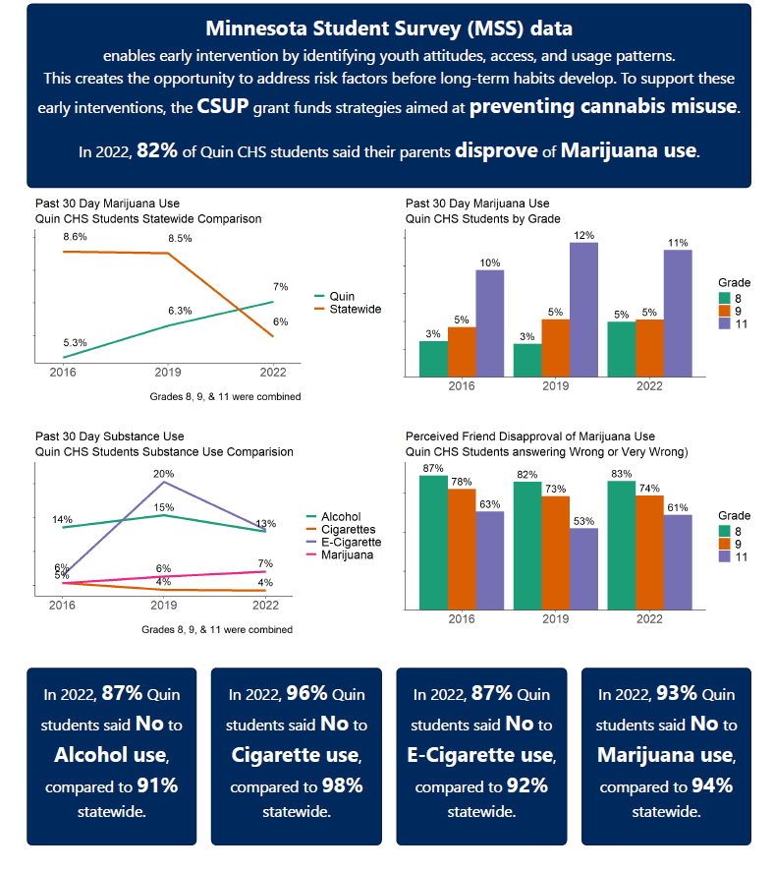
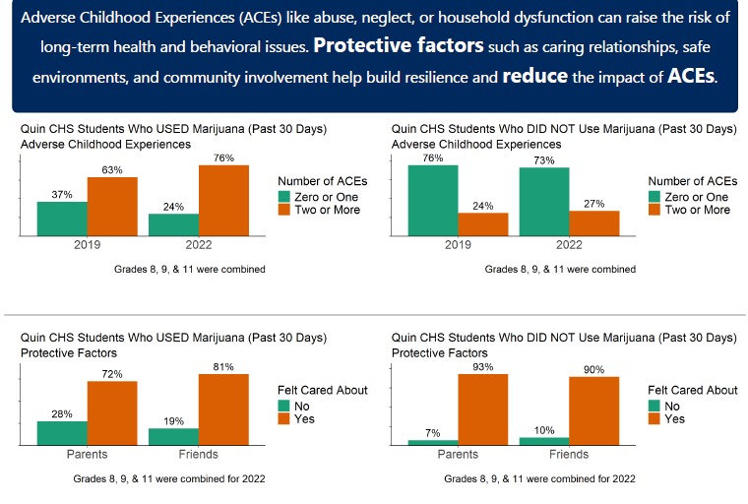
CSUP Needs Assessment
QUIN Community Health Board
Youth Baseline Assessment: Substance Use
Created by Patrick Olson, Data Analyst for Healthy QUIN Counties and Northwest 8
17

Slide 13

CSUP Needs Assessment
QUIN County Community Health Board
Youth Baseline Assessment: Substance Use
Continued
Nonfatal Drug Overdoses and Neonatal Abstinence
Due to insufficient data on nonfatal drug overdoses, we cannot find any accurate estimates for nonfatal drug overdoses for this population. However, there is data on the Nonfatal Drug Overdoses for the Northwest Region, which includes counties included in the QUIN County Community Health Board Region. ³³
According to the Minnesota Department of Health, there were 351 nonfatal hospital visits for all drug overdoses those 15-24 for the Northwest Region from 2016-2021. ³³
  103 were from opioid involved overdoses ³³
According to the Minnesota Department of Health, there were 50 cases of Neonatal Abstinence Syndrome (NAS) due to substance use from the mother in 2021.³³
From 2021-2024, there were a total of 22 drug arrests for <18.³³
**Data presented is from the Minnesota Department of Health’s Northwest Minnesota Drug and Opioid-Involved Data Overview from 2016-2021 to help guide interventions. These estimates are for the Northwest Region only, interpret with caution, as they may not be representative of the QUIN County Community Health Board Region. Confidence intervals and p-values were not available.
For more information, please visit:
Minnesota Student Survey
Nonfatal Drug Overdose Dashboard - MN Dept. of Health
Protecting Youth From the Harms of Vaping | Smoking and Tobacco Use | CDC
Cannabis and Teens | Cannabis and Public Health | CDC
Substance Use Among Youth | Reducing Health Risks Among Youth | CDC
About Underage Drinking | Alcohol Use | CDC
Created by Miranda Griechen, BA, MPH, Public Health Educator, Pennington & Red Lake County Public Health & Home Care
15
Notes:
Substance use data specific to QUIN was not available. To provide a meaningful context for this needs assessment, we calculated an average across them since they are demographically similar. While this aggregated data does not perfectly reflect QUIN’s exact trends, it offers a reasonable proxy to understand regional patterns and inform planning efforts. Limitations of this approach include potential variation in access to services, reporting practices, and population risk factors. Trends from the MSS were not added due too small of numbers and lack of variation.

Slide 14
CSUP Needs Assessment
QUIN County Community Health Board
Adult Baseline Assessment: Substance Use
**Data presented is from the Minnesota Behavioral Risk Factor Surveillance System from 2018-2023. These are weighted estimates. Confidence intervals are also given. Since they were quite wide and to help with clarity, these were omitted from the chart, interpret with caution.
Other Significant Findings
4.7% (1.6%, 13.0%) of residents in the QUIN County Community Health Board Region used Nicotine Pouches in 2023. ³²
7.9% (3.6%, 16.7%) of residents in the QUIN County Community Health Board Region used Cigarillos in 2023. ³²
25.5% of adults in the QUIN County Community Health Board Region had depression in 2022.
No data for QUIN County Community Health Board Region specifically. However, for the Northwest Region (which also comprises QUIN) had 424 overdoses in 2022. ³²
There were 230 drug arrests total for QUIN, with amphetamines/methamphetamines and marijuana being the most common drug. ²²
For 2024, it is expected that around 1% of residents reside in the QUIN County Community Health Board Region have dependence because of cannabis, cocaine, (Northwest Region only available). ³¹
  2% for opioid and 3% for alcohol use disorder
**Data presented is from the Minnesota Behavioral Risk Factor Surveillance System from 2018-2023. ³² These are weighted estimates. Confidence intervals are also given. Since they were wide quite wide and to help with clarity, these were omitted from the chart, interpret with caution. Data is also presented from the Minnesota Department of Health’s Nonfatal Drug Overdose Dashboard ²⁹, rates and estimates are standardized to the Minnesota population in 2020 using the US Census Bureau. Some data is suppressed due to unstable rates or privacy. Interpret with caution as all drug overdoses are suspected drug overdoses. Confidence intervals and p-values not available. Additionally, data is also from the Centers for Disease Control and Prevention PLACES data for 2022.³⁰ The prevalence of depression was age-adjusted for more accurate interpretations. Confidence intervals may be wide due to sample size limitations. The last bullet point comes from the MN EHR Consortium for 2024. ³¹
For more information, please visit:
PLACES: Local Data for Better Health | PLACES | CDC
Behavioral Risk Factor Surveillance System (BRFSS) - MN Dept. of Health
Nonfatal Drug Overdose Dashboard - MN Dept. of Health
Substance use - Health, United States
Treatment of Substance Use Disorders | Overdose Prevention | CDC
Front Page | Minnesota EHR Consortium
Statewide Trends in Drug Overdose: Preliminary 2023 Data Update
Created by Miranda Griechen, BA, MPH, Public Health Educator, Pennington & Red Lake County Public Health & Home Care
16

Slide 15
CSUP Needs Assessment
QUIN County Community Health Board
Adult Baseline Assessment: Pregnancy Substance Use
Other Significant Findings (MN PRAMS)
For the Minnesota Pregnancy Risk Assessment Monitoring System (MN PRAMS) 2023, 100 pregnant women were surveyed and asked substance use related questions.³⁴
  95% of pregnant people 20-34 were asked if they used cigarettes or e-cigarettes by a provider.
  94% of pregnant people 20-34 were asked if they used alcohol by a provider, 88% of pregnant people 35+ were asked
  81% of pregnant people 20-34 were asked if they used illegal drugs (similar for 35+)
  However, cannabis was the least asked question by providers only 75-78% for women 20-34 and 35+.
  Pregnant people 11% (20-34) and 16% (35+) reported smoking cigarettes for the past 2 years. 5% reported smoking in the last 3 months of pregnancy. ³⁴
    34% reported smoking less than half a pack during the last 3 months of pregnancy on an average day.
  Around 11% of pregnant people used e-cigarettes in the past 2 years.³⁴
    13% report using everyday the last 3 months of pregnancy.
    20% report using some days in the last 3 months of pregnancy.
    Most report using e-cigarettes to cut down on smoking (48%)
  Only 4% reported change smoking during pregnancy, with most pregnant people being nonsmokers (90%) ³⁴
  Overall, 29% of women drank during pregnancy (all trimesters).³⁴
    26-28% of pregnant people (<20, 20-34) drank alcohol during the first trimester.
    2-3% of women reported drinking in the second and third trimester.
    19% of pregnant people reported binge drinking during the first trimester.
  Binge drinkers were less likely to report anxiety as a potential reason for drinking in last 3 months of pregnancy. ³⁴
  However, more pregnant people had anxiety that smoked cigarettes during the last 3 months of pregnancy (55% versus 23% of nonsmokers). E-cigarettes showed a similar trend.³⁴
Data presented was provided by the Minnesota Pregnancy Risk Assessment Monitoring System for 2023.³⁴ All results were collected prior to the legalization of cannabis. Numbers were very small but were weighted estimates. Interpret with caution. Numbers were too small to separate out by county, like data from the MN BRFSS. Funding for MN PRAMS is made possible by grant number: U01DP006607-05-00 from the Department of Health and Human Services, Centers for Disease Control and Prevention, National Center for Chronic Diseased Prevention and Health Promotion.
For more information, please visit:
PLACES: Local Data for Better Health | PLACES | CDC
Behavioral Risk Factor Surveillance System (BRFSS) - MN Dept. of Health
Nonfatal Drug Overdose Dashboard - MN Dept. of Health
Substance use - Health, United States
Treatment of Substance Use Disorders | Overdose Prevention | CDC
Front Page | Minnesota EHR Consortium
Statewide Trends in Drug Overdose: Preliminary 2023 Data Update
Created by Miranda Griechen, BA, MPH, Public Health Educator, Pennington & Red Lake County Public Health & Home Care
16

Slide 16
CSUP Needs Assessment
QUIN Community Health Board
Summary of Findings
Current Existing Data
Cannabis potency has been increasing since 2014.
Cannabis use has increased since legalization, especially in adults.
  Most youth report not using cannabis.
Cannabis use increases the risk of mental health conditions and psychiatric symptoms, especially for youth due to development.
Cannabis use during pregnancy can have adverse effects for infants.
There has been decreases in alcohol, cigarette, e-cigarette, and illicit drug use from 1991-2021 in youth.
Alcohol use is positively associated with many diseases. No amount of alcohol is considered safe to consume.
Low perceptions of harm were identified across all substances, but especially marijuana for youth.
Youth commonly accessed substances from friends or parents.
Alcohol and vaping were identified as the most widely used substances across youth.
Alcohol use, especially binge drinking, was common among adults.
Marijuana, especially after legalization, has increased among adults.
Methamphetamine and marijuana were the most common drug offenses.
Substance use among pregnant babies was almost 30% in QUIN, highlighting the need for education around the harms of substances for pregnant people and their babies. n
Current local data is lacking. More accurate and representative data, especially by demographics, is needed to find risk and protective factors to create effective interventions.
  Advocation for the Minnesota Student Survey and other collection methods in Minnesota
  Collecting cannabis use on the MN PRAMS
  Collect data on chronic conditions, not just health behaviors, to understand adverse effects of cannabis for youth.
  Better collection of overdose, poisoning, and pregnancy data regarding cannabis
  To add substance related issues to survey for QUIN Community Health Assessment
18

Slide 17
CSUP Needs Assessment
References
Prevention Technology Transfer Center (PTTC) Network. Introduction to Substance Abuse Prevention: Understanding the Basics (Pre-SAPST Course) - Prevention Technology Transfer Center (PTTC) Network. Published June 11, 2024. Accessed May 5, 2025.https://pttcnetwork.org/products_and resources/introduction-to-substance-abuse-prevention-understanding-the-basics-pre-sapst-course/
National Institute on Drug Abuse (n.d.). Preventing Drug Use among Children and Adolescents: A Research-Based Guide for Parents, Educators, and Community Leaders .
SAMHSA. “Risk and Protective Factors.” 18 July 2019.
CDC. YRBS Prevalence & Trends Database, All Years.
CDC. BRFSS Prevalence & Trends Data: Home. Centers for Disease Control and Prevention. Published 2023. https://www.cdc.gov/brfss/brfssprevalence/index.html
Federal Bureau of Investigation. Persons Arrested. FBI. Published 2019. https://ucr.fbi.gov/crime-in-the-u.s/2019/crime-in-the-u.s.-2019/topic-pages/persons-arrested
CDC. U.S. overdose deaths decrease Almost 27% in 2024. Cdc.gov. Published May 9, 2025. https://www.cdc.gov/nchs/pressroom/nchs_press_releases/2025/20250514.htm
Danielson RA, Schmidt M, Griechen MA. Adverse childhood experiences affect health outcomes for adults in North Dakota: 2019-2022 BRFSS population profile. Front Public Health. 2025;13:1517431. Published 2025 May 30. doi:10.3389/fpubh.2025.1517431
Smith A, Kaufman F, Sandy MS, Cardenas A. Cannabis Exposure During Critical Windows of Development: Epigenetic and Molecular Pathways Implicated in Neuropsychiatric Disease. Curr Environ Health Rep. 2020;7(3):325-342. doi:10.1007/s40572-020-00275-4
Young-Wolff KC, Adams SR, Alexeeff SE, et al. Prenatal Cannabis Use and Maternal Pregnancy Outcomes. JAMA Intern Med. 2024;184(9):1083-1093. doi:10.1001/jamainternmed.2024.3270
Solmi M, De Toffol M, Kim JY, et al. Balancing risks and benefits of cannabis use: umbrella review of meta-analyses of randomised controlled trials and observational studies. BMJ. 2023;382:e072348. Published 2023 Aug 30. doi:10.1136/bmj-2022-072348
Robinson T, Ali MU, Easterbrook B, et al. Identifying risk-thresholds for the association between frequency of cannabis use and development of cannabis use disorder: A systematic review and meta-analysis. Drug Alcohol Depend. 2022;238:109582. doi:10.1016/j.drugalcdep.2022.109582
Im PK, Wright N, Yang L, et al. Alcohol consumption and risks of more than 200 diseases in Chinese men. Nat Med. 2023;29(6):1476-1486. doi:10.1038/s41591-023-02383-8
Hussain A, Johansen MC, Blaha MJ, et al. Predictors of incident stroke among individuals without coronary artery calcification: A pooled cohort analysis from the Multi-Ethnic Study of Atherosclerosis, Jackson Heart Study, and Framingham Heart Study. Vasc Med. 2024;29(6):632-639. doi:10.1177/1358863X241270911
Chang JT, Anic GM, Rostron BL, Tanwar M, Chang CM. Cigarette Smoking Reduction and Health Risks: A Systematic Review and Meta-analysis. Nicotine Tob Res. 2021;23(4):635-642. doi:10.1093/ntr/ntaa156
Mirahmadizadeh A, Hassanzadeh J, Moradi AM, Gheibi Z, Heiran A. Projection of the prevalence of tracheal, bronchus, and lung cancer incidence using cigarette smoking prevalence in Iran from 1990 to 2018: a comparison of latent period-based models with standard forecasting models. BMC Public Health. 2024;24(1):1896. Published 2024 Jul 15. doi:10.1186/s12889-024-19407-8
Zhao X, Wang Y, Liang C. Cigarette smoking and risk of bladder cancer: a dose-response meta-analysis. Int Urol Nephrol. 2022;54(6):1169-1185. doi:10.1007/s11255-022-03173-w
Scala M, Bosetti C, Bagnardi V, et al. Dose-response Relationships Between Cigarette Smoking and Breast Cancer Risk: A Systematic Review and Meta-analysis. J Epidemiol. 2023;33(12):640-648. doi:10.2188/jea.JE20220206 doi:10.3389/fpubh.2024.1497745
Comiford A, Pan S, Chen S. Respiratory chronic health conditions and racial disparities associated with e-cigarette use: a cross-sectional analysis using behavioral risk factor surveillance data. Front Public Health. 2024;12:1497745. Published 2024 Dec 10.
Minnesota Department of Health. Cannabis Use in Minnesota: Baseline Assessment 2024. Published 1 July 2024.
Minnesota Department of Education. “Minnesota Student Survey.” Mn.gov, 2022, education.mn.gov/MDE/dse/health/mss/.
Home Page | Minnesota Drug Crimes and Overdose Dashboard | Bureau of Criminal Apprehension. State.mn.us. Published 2025. https://bcadataportal.state.mn.us/DMI
Drug Overdose Dashboard - MN Dept. of Health. State.mn.us. Published 2023. Accessed September 5, 2025. https://www2cdn.web.health.state.mn.us/communities/opioids/opioid-dashboard/index.html
Minnesota Department of Health. Behavioral Risk Factor Surveillance System 2023 dataset.
Minnesota Office of Cannabis Management . Chronic Pain Patients in Minnesota Medical Cannabis Program 31 January 2025.
Gupta, Johnson PJ. Impact of Marijuana Use On Self Reported Mental Health Status Among Adults in Minnesota. North Dakota State University-Department of Public Health, 2025.
DeLaquil, M., Giesel, S. (2024) Statewide Trends in Drug Overdose: Preliminary 2023 Update, Data Brief. Minnesota Department of Health.
County Health Rankings. Minnesota Counties 2025.
Minnesota Department of Health. “County-Level Nonfatal Overdoses by County of Residence, 2016-2020 - Minnesota Department of Health.” Www.health.state.mn.us, www.health.state.mn.us/communities/opioids/data/nonfataldata.html.
Center for Disease Control. PLACES: Local Data for Better Health 2022.Centers for Disease Control and Prevention. Published March 8, 2021https://www.cdc.gov/places/index.html
Health Trends Across Communities in Minnesota Dashboard | Minnesota EHR Consortium. mnehrconsortium.org. https://mnehrconsortium.org/health-trends-across-communities-minnesota-dashboard
Minnesota Department of Health. “Behavioral Risk Factor Surveillance System (BRFSS) – 2018-2023, Minnesota Department of Health.” Www.health.state.mn.us, www.health.state.mn.us/data/mchs/surveys/brfss/index.html.
Lovett, Sara. Northwest Minnesota Drug and Opioid-Involved Data Overview. Minnesota Department of Health , 23 November 2023.
Minnesota Department of Education. “Minnesota Student Survey.” Mn.gov, 2019, education.mn.gov/MDE/dse/health/mss/.
PRAMS Data 2023 - MN Dept. of Health. State.mn.us. Published 2016. Accessed September 2, 2025. https://www.health.state.mn.us/people/womeninfants/prams/data.html‌
19
Notes:
Minnesota Student Survey
Front Page | Minnesota EHR Consortium
Mental Health – 2023-2025 Community Health Assessment Preliminary (real source: PLACES: Local Data for Better Health | PLACES | CDC)
Nonfatal Drug Overdose Dashboard - MN Dept. of Health
Preventing Drug Use Among Children and Adolescents -- A Research-Based Guide for P
20190718-samhsa-risk-protective-factors.pdfarents, Educators, and Community Leaders
Behavioral Risk Factor Surveillance System (BRFSS) – MN Dept. of Health
Statewide Trends in Drug Overdose: Preliminary 2023 Data Update
Title Slide with Image
**Don’t forget the Adverse Childhood Experiences Paper to Cite
New references to put on here and number on the PPT:
Nonfatal Drug Overdose Dashboard - MN Dept. of Health
Drug Arrests | Minnesota Drug Crimes and Overdose Dashboard | Bureau of Criminal Apprehension
Substance Use in Minnesota - SUMN.org
FBI — Table 29
Products - Data Briefs - Number 522 - December 2024
Maternal alcohol intake in early pregnancy and biomarkers of fecundity in adult sons: A cohort study – PubMed
Active and Passive Maternal Smoking During Pregnancy and Birth Outcomes: A Study From a Developing Country – PMC
Buprenorphine versus Methadone for Opioid Use Disorder in Pregnancy – PMC
U.S. Overdose Deaths Decrease Almost 27% in 2024

